Slide 1

Enhancing Search Engine Relevance for Video Subtitles
Mohd Sardar

Slide 2

Objective:
Develop an advanced search engine algorithm that efficiently retrieves subtitles based on user queries, with a specific emphasis on subtitle content. The primary goal is to leverage natural language processing and machine learning techniques to enhance the relevance and accuracy of search results.

Slide 3
Introduction :
Search Engine is a tool that helps to extract relevant contents from the huge amount of data. In the current landscape, Google maintains a steadfast commitment to ensuring a
seamless and precise search experience above all other considerations. Our project focuses on improving the search relevance for video subtitles, enhancing the accessibility of video content.

Slide 4
Keyword Based Search Engine:
These search engines rely heavily on exact keyword matches between the user query and the indexed documents. It focus primarily on matching exact keywords in documents

Slide 5
Semantic Based Search Engine :
Semantic search engines go beyond simple keyword matching to understand the meaning and context of user queries and documents.Aim to understand the deeper meaning and context of user queries to deliver more relevant and meaningful search results.

Slide 6
Process:
1.Data Sampling 2.Data Preprocessing 3.Document chunker 4.Text Vectorization
5.Storing Embeddings 6.Retriving Documents

Slide 7
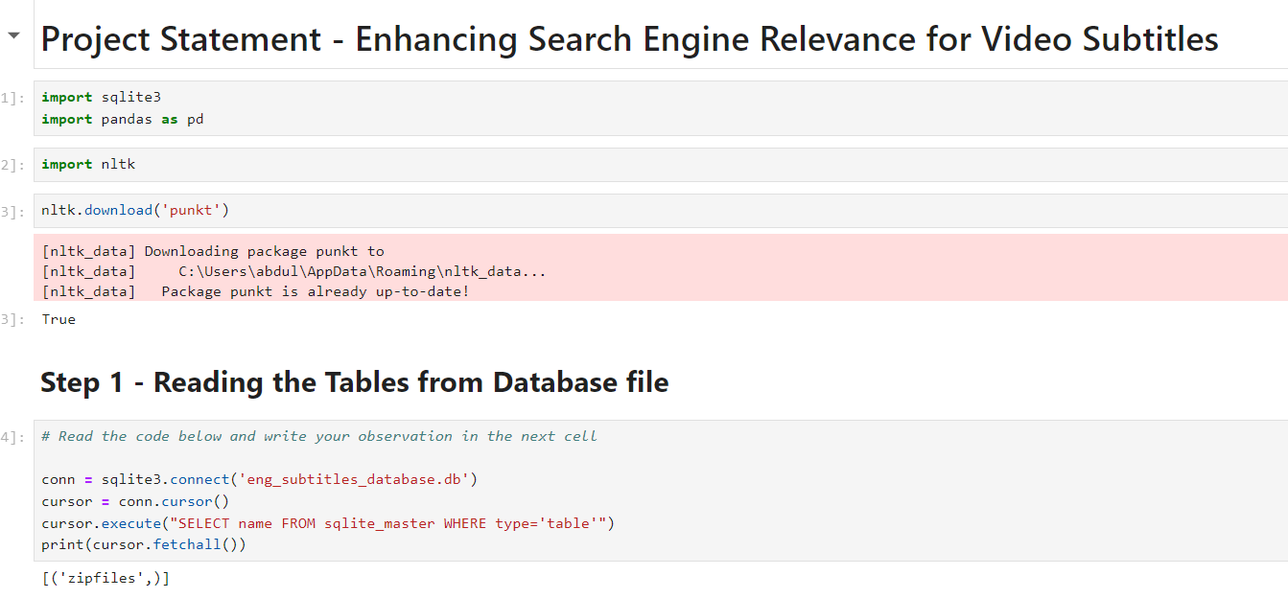

Slide 8
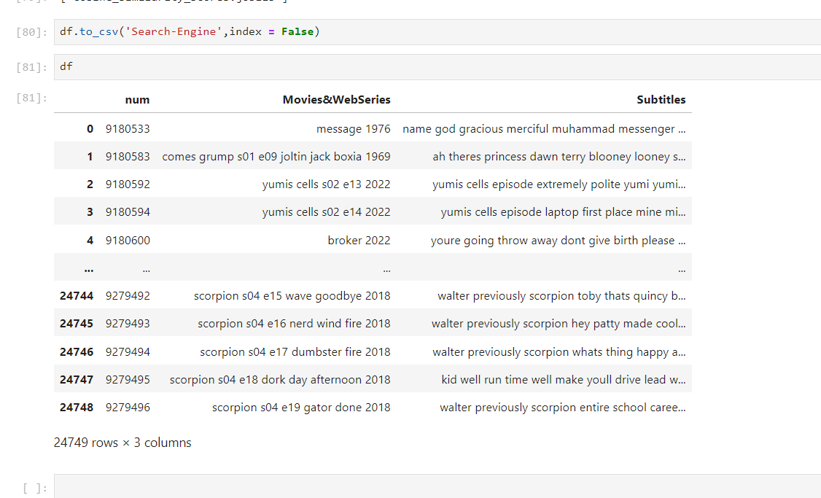

Slide 9
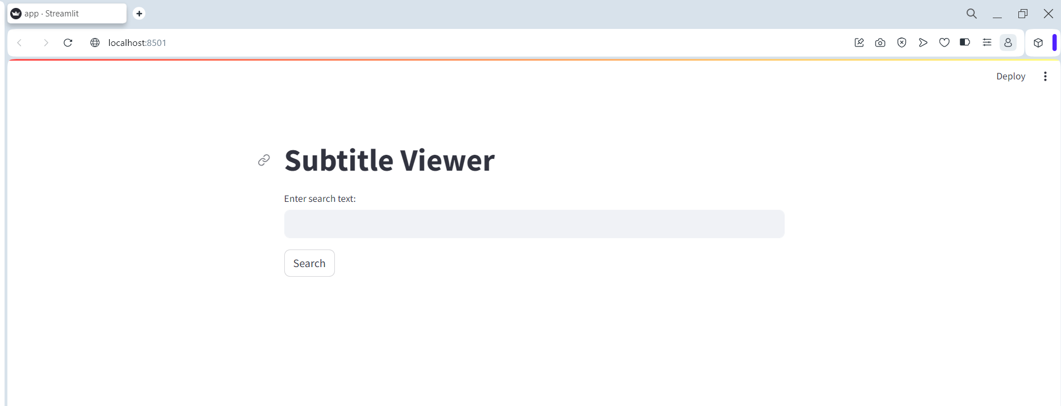
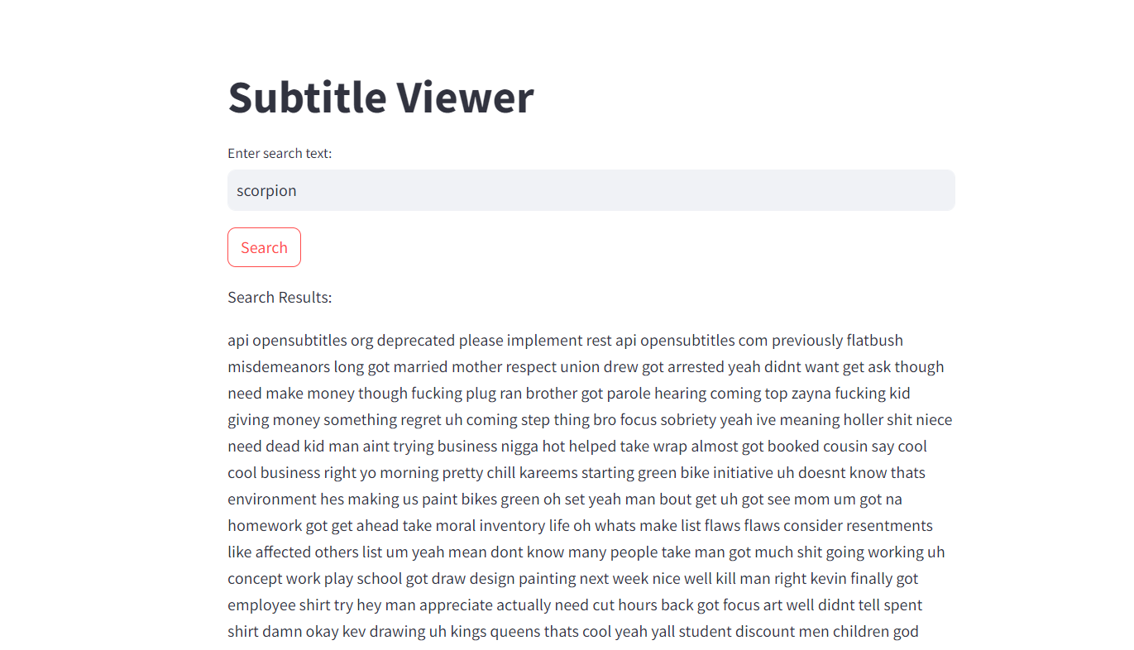

Slide 10


